Slide 1
Kostamuksha school №1 named after Yaakko Rugoev

Slide 2
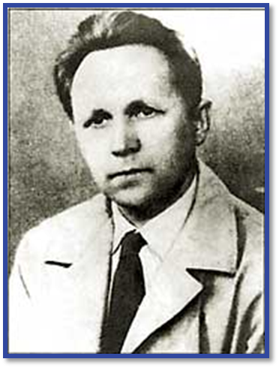
Yaakko Vasilyevich Rugoev

Slide 3
Yaakko Rugoev
Yakko Vasilievich Rugoev is a Karelian Soviet writer and a poet.

Slide 4
Rugoev liked to study and hе was eager to learn. And he also liked reading. His grandmother read him different stories and epics. Later he used them in his works.

Slide 5
Yaakko Rugoev’s works were printed when he was 16 years old, still a schoolboy. His correspondence and poetry were published in magazines and collections.

Slide 6
Yaakko Rugoev with his brother Ivan 1937

Slide 7
In 1943 he worked as a military correspondent in the paper «Totuus». In the same year he published his first book, a collection of partisan stories and essays «Kosto»

Slide 8
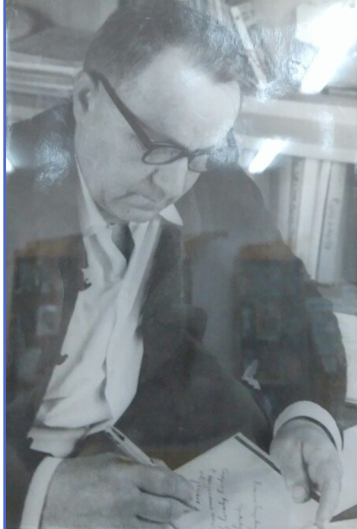
Yaakko Rugoev wrote about
love
his native language
the war
memory
nature
people
the Motherland

Slide 9
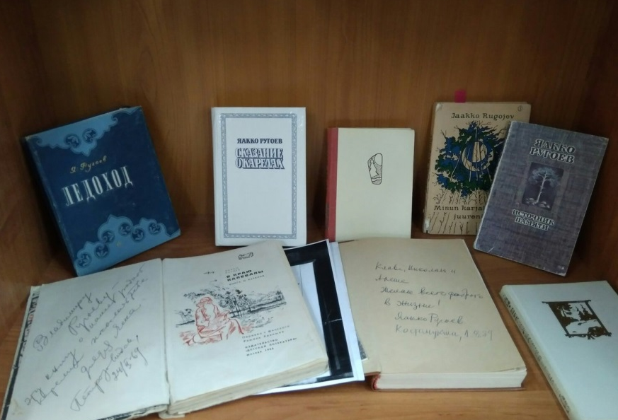
“Pekka and Anya”
“Trostnikoviy bereg”
“Skazanie o karelakh”
“Mest”
“Ozera”

Slide 10
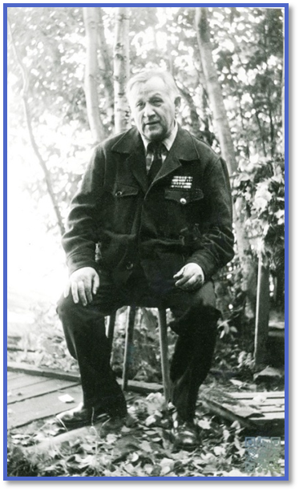
”The heart is rich in memories…”, as it is written in one of his works.

